Slide 1
CMSC 207
Discrete Structure
Lecture 01
© Vadim Bulitko - CMPUT 272, Winter 2004, UofA

Slide 2
Why This Course?
Relation to real life:
  Algorithm correctness ~ programming, reverse-engineering, debugging
  Propositional logic ~ hardware (including VLSI) design
  Sets/relations ~ databases (Oracle, MS Access, etc.)
  Predicate logic ~ Artificial Intelligence, compilers
  Proofs ~ Artificial Intelligence, VLSI, compilers, theoretical physics/chemistry
Lecture 01
© Vadim Bulitko - CMPUT 272, Winter 2004, UofA

Slide 3
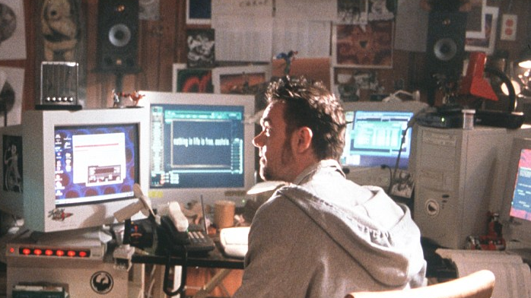
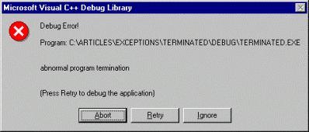
Code Correctness
Millions of programmers code away daily…
How do we know if their code works?
Lecture 01
© Vadim Bulitko - CMPUT 272, Winter 2004, UofA

Slide 4
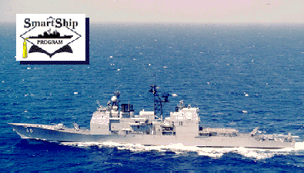
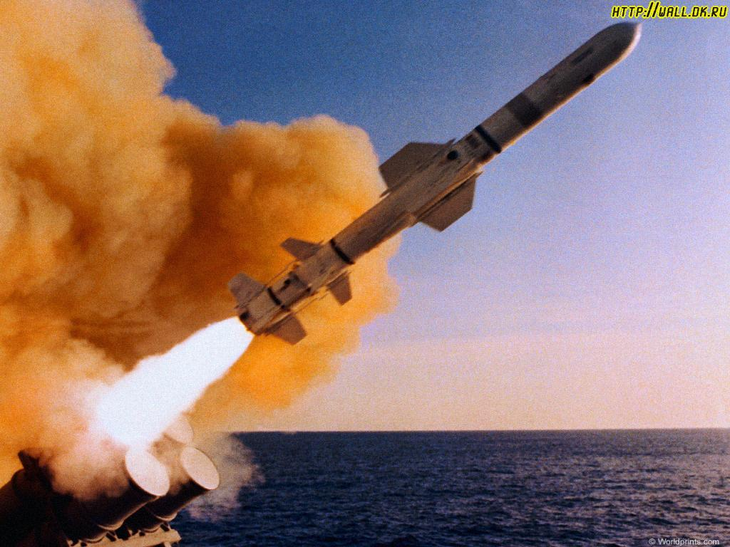
Importance
USS Yorktown, a guided-missile cruiser --- the first to be outfitted with Smart Ship technology
09/97: suffered a widespread system failure off the coast of Virginia.
After a crew member mistakenly entered a zero into the data field of an application, the computer system proceeded to divide another quantity by that zero.
The operation caused a buffer overflow, in which data leak from a temporary storage space in memory, and the error eventually brought down the ship's propulsion system.
The result: the Yorktown was dead in the water for more than two hours.
Lecture 01
© Vadim Bulitko - CMPUT 272, Winter 2004, UofA

Slide 5
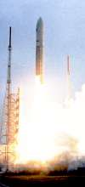
More Software Bugs…
On June 4, 1996, the maiden flight of the European Ariane 5 launcher crashed about 40 seconds after takeoff. Media reports indicated that the amount lost was half a billion dollars -- uninsured.
The exception was due to a floating-point error: a conversion from a 64-bit integer to a 16-bit signed integer, which should only have been applied to a number less than 2^15, was erroneously applied to a greater number, representing the "horizontal bias" of the flight.
There was no explicit exception handler to catch the exception, so it followed the usual fate of uncaught exceptions and crashed the entire software, hence the on-board computers, hence the mission.
Lecture 01
© Vadim Bulitko - CMPUT 272, Winter 2004, UofA

Slide 6



Where is CMSC 207 ?
How do we find such bugs in software?
  Tracing
  Debug statements
  Test cases
  Many software testers working in parallel…
All of that had been employed in the previous cases
Yet the disasters occurred…
Lecture 01
© Vadim Bulitko - CMPUT 272, Winter 2004, UofA

Slide 7

CMSC207 : Program Correctness
Logic : means to prove correctness of software
Sometimes can be semi-automated
Can also verify a provided correctness proof
Lecture 01
© Vadim Bulitko - CMPUT 272, Winter 2004, UofA

Slide 8
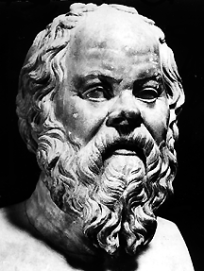
Argument #1
All men are mortal
Socrates is a man
Therefore,
Socrates is mortal
Lecture 01
© Vadim Bulitko - CMPUT 272, Winter 2004, UofA

Slide 9
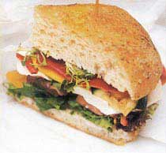
Argument #2
Nothing is better than God
A sandwich is better than nothing
Therefore,
a sandwich is better
than God
Lecture 01
© Vadim Bulitko - CMPUT 272, Winter 2004, UofA

Slide 10
Validity
An argument is valid if and only if given that its premises hold its conclusion also holds
So…
  Socrates argument: Valid or Invalid?
  Sandwich argument: Valid or Invalid?
Lecture 01
© Vadim Bulitko - CMPUT 272, Winter 2004, UofA

Slide 11
How can we tell ?
Common sense?
Voting?
Authority?
What is valid argument anyway?
Who cares?
???
Lecture 01
© Vadim Bulitko - CMPUT 272, Winter 2004, UofA

Slide 12
CMSC 207
Logic : a formal way to assess a validity of an argument
Can prove theorems in a semi-automatic fashion
Can verify given proofs that an argument is valid
Lecture 01
© Vadim Bulitko - CMPUT 272, Winter 2004, UofA

Slide 13
Material Coverage
Chapter 1: propositional calculus
Chapter 2: 1st order predicate calculus
Chapter 3: number theory
Chapter 4: mathematical induction
Chapter 5: set theory
Chapter 6: counting / probabilities
Chapter 7: functions
Chapter 10: relations (not the ♥ kind)
Lecture 01
© Vadim Bulitko - CMPUT 272, Winter 2004, UofA

Slide 14

Questions?
Lecture 01
© Vadim Bulitko - CMPUT 272, Winter 2004, UofA

Slide 15
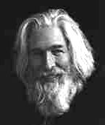
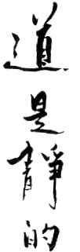
What is the name of this man?
Lecture 01
© Vadim Bulitko - CMPUT 272, Winter 2004, UofA

Slide 16
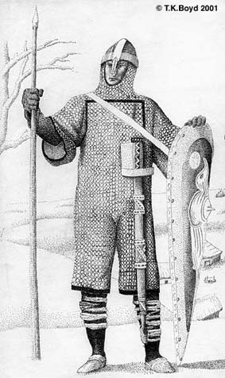
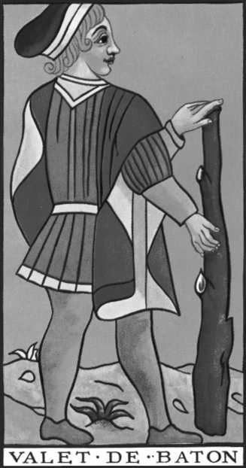
Arguments in Puzzles
The Island of Knights and Knaves
Never lie
Always lie
Lecture 01
© Vadim Bulitko - CMPUT 272, Winter 2004, UofA

Slide 17
Example #1
You meet two people: A, B
A says:
  I am a Knave or B is a Knight.
Who is A?
Who is B?
Lecture 01
© Vadim Bulitko - CMPUT 272, Winter 2004, UofA

Slide 18

Solution
The original statement can be written as:
S = X or Y
X = “A is a Knave”
Y = “B is a Knight”
Suppose A is a Knave
Then S must be false since A said it
Then both X and Y are false
If X is false then A is not a Knave
Contradiction : A cannot be a Knave and not a Knave !
So A must be a Knight
So S is true and X is not true
Thus, to keep S true Y must be true
So B is a Knight too
Lecture 01
© Vadim Bulitko - CMPUT 272, Winter 2004, UofA

Slide 19

How about…
You meet just one guy : A
A says:
  “I’m a Knave!”
Who is A?
Lecture 01
© Vadim Bulitko - CMPUT 272, Winter 2004, UofA

Slide 20
Features Of An Argument
arguments involve things or objects
things have properties
arguments consist of statements
statements may be composed
an argument starts with assumptions which create a context.
each step yields another statement which is true, within its context.
arguments may contain sub-arguments
it is absurd for a statement to be both true and false
Lecture 01
© Vadim Bulitko - CMPUT 272, Winter 2004, UofA

Slide 21
Formalization
Why formalize?
  to remove ambiguity
  to represent facts on a computer and use it for proving, proof-checking, etc.
  to detect unsound reasoning in arguments
Lecture 01
© Vadim Bulitko - CMPUT 272, Winter 2004, UofA

Slide 22
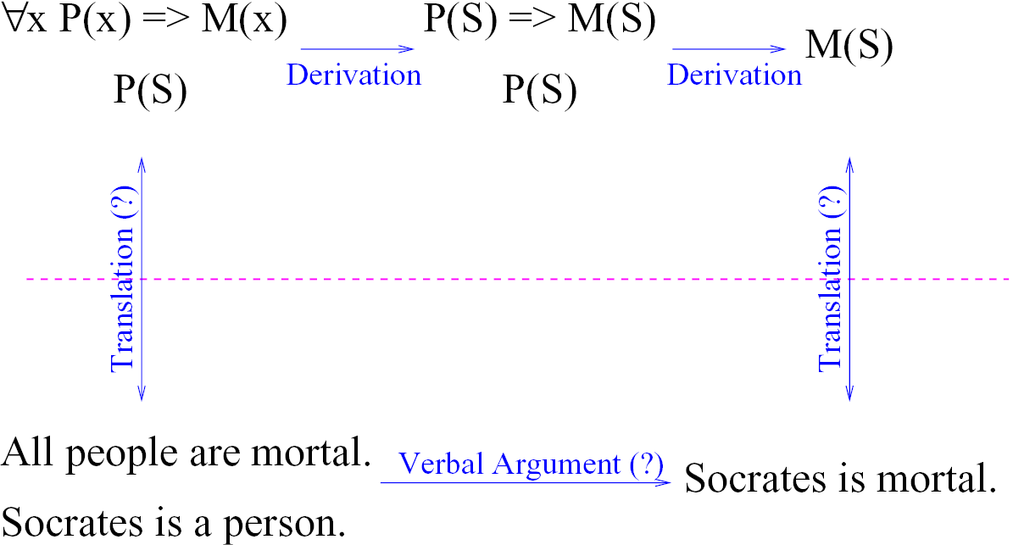
Graphically…
Lecture 01
© Vadim Bulitko - CMPUT 272, Winter 2004, UofA

Slide 23
Logic
Mathematical logic is a tool for dealing with formal reasoning
In a nutshell:
Logic does:
  Assess if an argument is valid/invalid
Logic does not directly:
  Assess the truth of atomic statements
Lecture 01
© Vadim Bulitko - CMPUT 272, Winter 2004, UofA

Slide 24
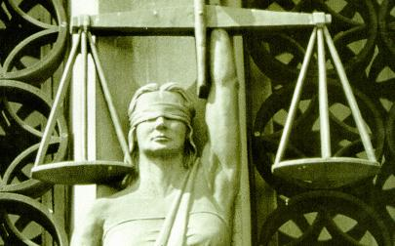
Differences
Logic can deduce that:
  Edmonton is in Canada
given these facts:
  Edmonton is in Alberta
  Alberta is a part of Canada
and the definitions of:
  ‘to be a part of’
  ‘to be in’
Logic knows nothing of whether these facts actually hold in real life!
Lecture 01
© Vadim Bulitko - CMPUT 272, Winter 2004, UofA

Slide 25
Questions?
Lecture 01
© Vadim Bulitko - CMPUT 272, Winter 2004, UofA

Slide 26
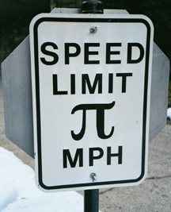

Propositional Calculus (Ch 1.)
Simplest kind of math logic
Dealing with:
  Propositions: X,P,Q,…
  each can be true or false
  Examples: P=“I’m a knave”
  Q=“He is a knight”
  Connectives: &, v, →, ⬄, ~, …
    connect propositions: X v Y
Lecture 01
© Vadim Bulitko - CMPUT 272, Winter 2004, UofA

Slide 27
Connectives
Different notation is in use
We will use the common math notation:
  ~ not
  V or (non-exclusive!)
  & and
  → implies (if … then …)
  ⬄ if and only if
  ∀ for all
  ∃ exists
See the reverse of the text’s front cover
Lecture 01
© Vadim Bulitko - CMPUT 272, Winter 2004, UofA

Slide 28
Formulae
A statement/proposition: true or false
Atomic: P, Q, X, Y, …
Unit Formula: P, ~P, (formula), …
Conjunctive: P & Q, P & ~Q, …
Disjunctive: P v Q, P v (P & X),…
Conditional: P → Q
Biconditional: P ⬄ Q
Lecture 01
© Vadim Bulitko - CMPUT 272, Winter 2004, UofA

Slide 29
Determining Truth of A Formula
Atomic formulae: given
Compound formulae: via meaning of
the connectives
Suppose: P is true
Q is false
How about: (P v Q)
Truth tables
Lecture 01
© Vadim Bulitko - CMPUT 272, Winter 2004, UofA

Slide 30
Truth Tables
Suppose: P is false
Q is false
X is true
How about:
  P & Q & X
  P v Q & X
  P & Q v X
Lecture 01
© Vadim Bulitko - CMPUT 272, Winter 2004, UofA

Slide 31
Precedence
~ highest
&
v
→, ⬄ lowest
Avoid confusion - use ‘(‘ and ‘)’:
  P & Q v X
  (P & Q) v X
Lecture 01
© Vadim Bulitko - CMPUT 272, Winter 2004, UofA

Slide 32
Parenthesizing
Parenthesize & build truth tables
Similar to arithmetics:
  3*5+7 = (3*5)+7 but NOT 3*(5+7)
  A&B v C = (A&B) v C but NOT A&(B v C)
So start with sub-formulae with highest-precedence connectives and work your way out
Let’s do the knave & knight problem in TT
Lecture 01
© Vadim Bulitko - CMPUT 272, Winter 2004, UofA

Slide 33
TT for K&K
S = X or Y
X = “A is a Knave”
Y = “B is a Knight”
A B S X Y X v Y Absurd
------------------------------------------------------------------------------
Knave Knave false true false true yes
Knave Knight false true true true yes
Knight Knave true false false false yes
Knight Knight true false true true no
Lecture 01
© Vadim Bulitko - CMPUT 272, Winter 2004, UofA

Slide 34
Questions?
Lecture 01
© Vadim Bulitko - CMPUT 272, Winter 2004, UofA

